Slide 1


Malaviya National Institute of Technology
Jaipur
Presentation
on
Texas Instruments Internship
SUBMITTED TO
Dr. Dipti Saxena
(Associate Professor)
SUBMITTED BY
Aditya Kumar Jha
(2022UEE1038)

Slide 2
List of Contents
Validation and testing of ICs
Block Diagram of RI Testing
Earlier Signal Chain Setup
Proposed Testing Procedure
Scope of Further Improvement
Question And Answer
IEC-61000-4
Digital Isolators
Introduction to EMC testing of ICs

Slide 3
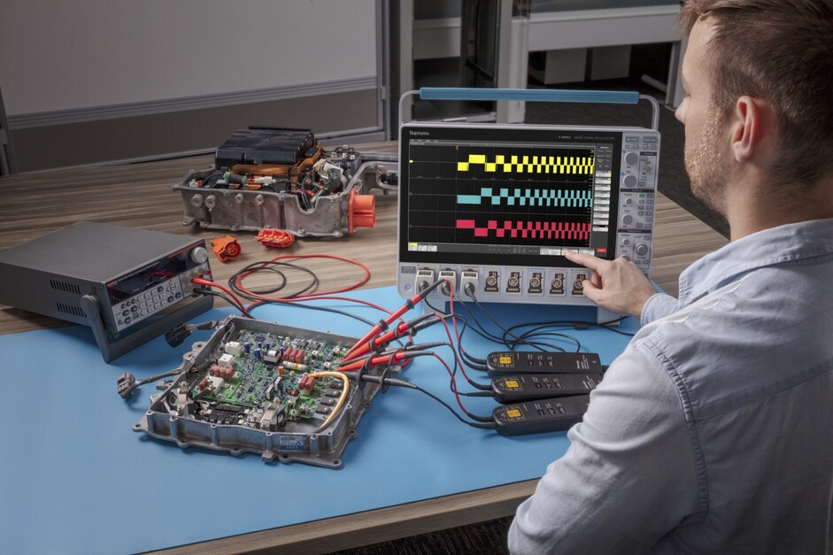
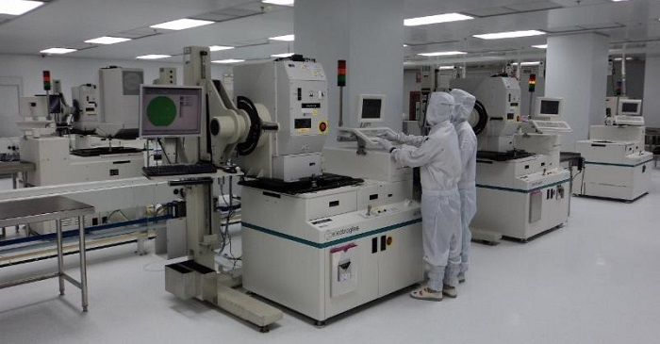
Validation and Testing of ICs
Validation of ICs
Process of measuring and characterizing IC performance in the lab against design specifications.
Involves detailed analysis of parameters (gain, noise, offset, PSRR, speed, etc.) across corners.
Importance: Ensures the IC meets functional and performance goals before mass production.
Testing of ICs
Process of screening ICs at wafer and package level using ATE for pass/fail criteria.
Focuses on functional checks, DC/AC parameters, and defect detection at scale.
Importance: Guarantees quality, yield, and reliability in high-volume manufacturing.

Slide 4
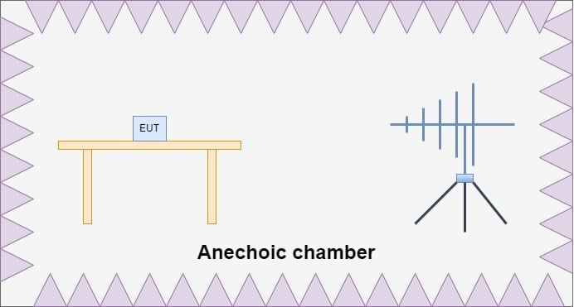
Introduction to EMC testing of ICs
Electromagnetic Compatibility (EMC) testing is the process of evaluating an electronic device to ensure it does not emit an excessive amount of electromagnetic interference (EMI), and that it can operate correctly in the presence of EMI in its environment. These emissions—both radiated and conducted—must fall within defined regulatory limits to avoid interference with other equipment.
EMC testing includes two core objectives:
Emissions Testing – Ensuring your device does not generate unwanted interference.
Immunity Testing – Confirming your device continues functioning as intended when exposed to external electromagnetic disturbances.

Slide 5
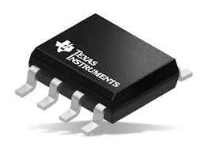
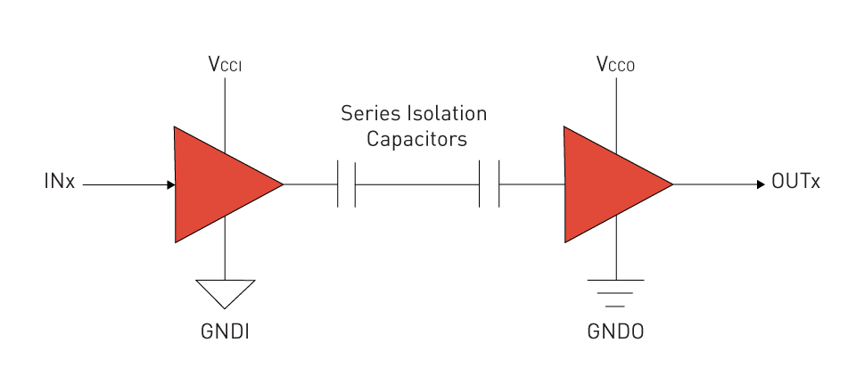
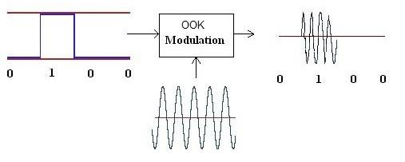
Digital Isolators
Digital isolators are devices used to transfer digital signals across two electrically isolated domains while preventing direct conduction of current. They’re widely used in systems where safety, noise immunity, and protection from high voltages are critical.
Digital isolators use non-conductive coupling methods instead of wires:
Capacitive Coupling: Uses tiny on-chip capacitors to transmit digital transitions via electric fields.
Magnetic Coupling: Uses micro-scale transformers or inductive coils to send signals via magnetic fields.
Optical Coupling (Optocouplers): Uses LEDs and photodiodes for light-based signal transfer (older but still common).
Digital isolation is needed for following reason: Safety of devices and Noise Immunity

Slide 6
IEC-61000-4(Standard for EMC testing)
IEC-61000-4 specifies how EMC immunity tests must be conducted so that equipment can be evaluated under controlled, repeatable conditions.
IEC-61000-4-3 is specifically concerned with radiated immunity testing ICs. It ensures that equipment continues to operate correctly and safely when exposed to RF radiation (like from mobile phones, walkie-talkies, Wi-Fi, radar, broadcast transmitters, etc.).
Test Case Parameter | Values
Frequency range of EMF | 1-6 GHz
Field strength levels | Greater than 100 V/m
Data Rate | 100Mbps
Step size | 0.1GHz
Time taken per step | 3 second
Performance level | Description
Criterion A | Normal Performance
Criterion B | Temporary degradation, but self-recovering
Criterion C | Temporary degradation and require reset
Criterion D | Complete failure
Testing standard
Performance Criterion

Slide 7
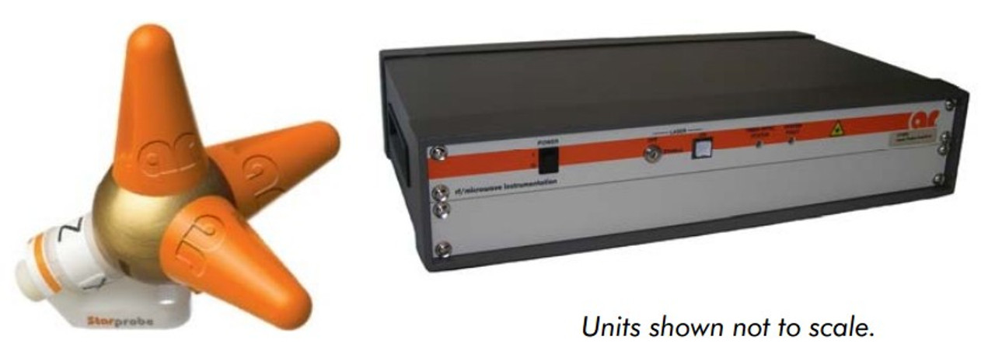
Block Diagram of RI testing
Test Signal Generator
DUT
Power Amplifier
Horn Antenna
Electromagnetic Radiation Field
Field Probe
Probe Interface
Data
Power

Slide 8
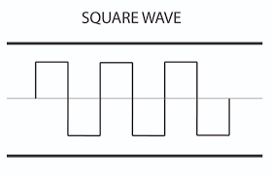
Earlier Signal Chain Setup
+5V
GND1
+5V
GND2
+3.3V
GND1
5V square wave
3.3V square wave
Microprocessor
Isolation
Loop back
Voltage Level Translators
LED output
LED lights up if there is mismatch in sent and received data (bit-miss)

Slide 9
Proposed Testing Procedure
Setup: Place DUT in anechoic chamber, power via isolated battery/LDO; connect data through optical–electrical converters.
Calibration: Establish reference data pattern (PRBS) and calibrate RF field strength at DUT location.
Exposure: Sweep 1GHz–6 GHz with @ 100MHz; apply required field strength levels. At this time input data is being transferred inside the anechoic chamber at 100Mbps
Monitoring: Continuously check received data for bit errors, glitches, or link loss.
Evaluation: Classify immunity per IEC criteria (A–D) and document failure thresholds. Set up related triggers for glitch detection.

Slide 10
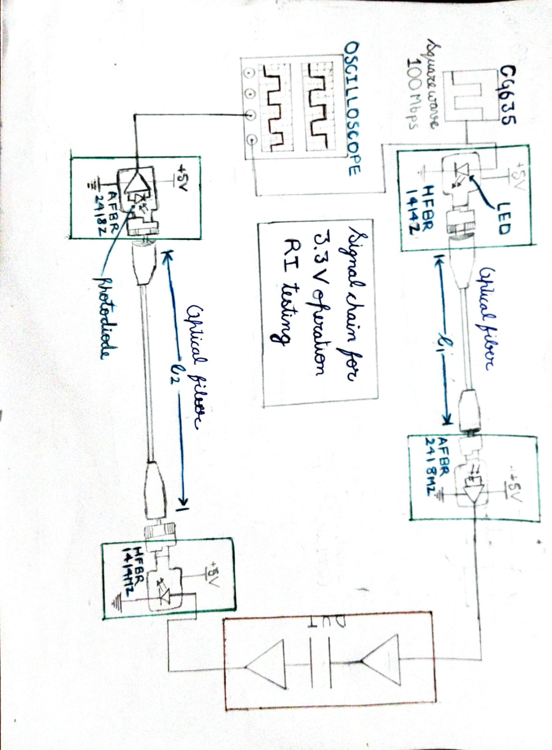
Block Diagram of new setup

Slide 11
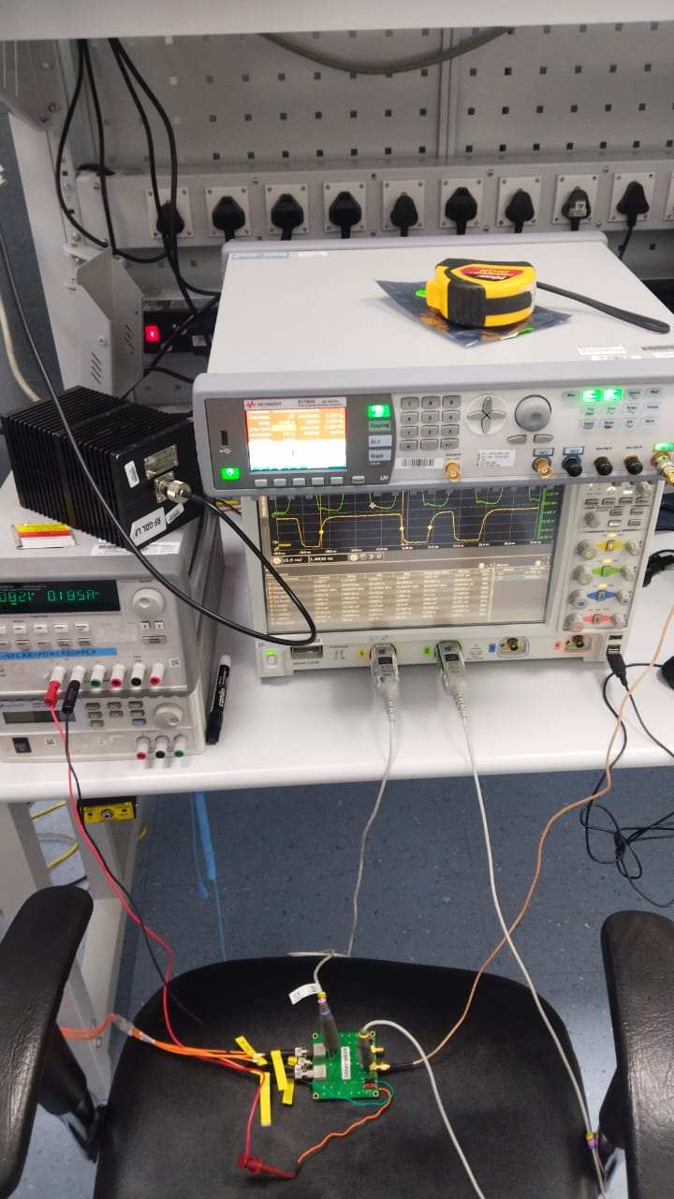
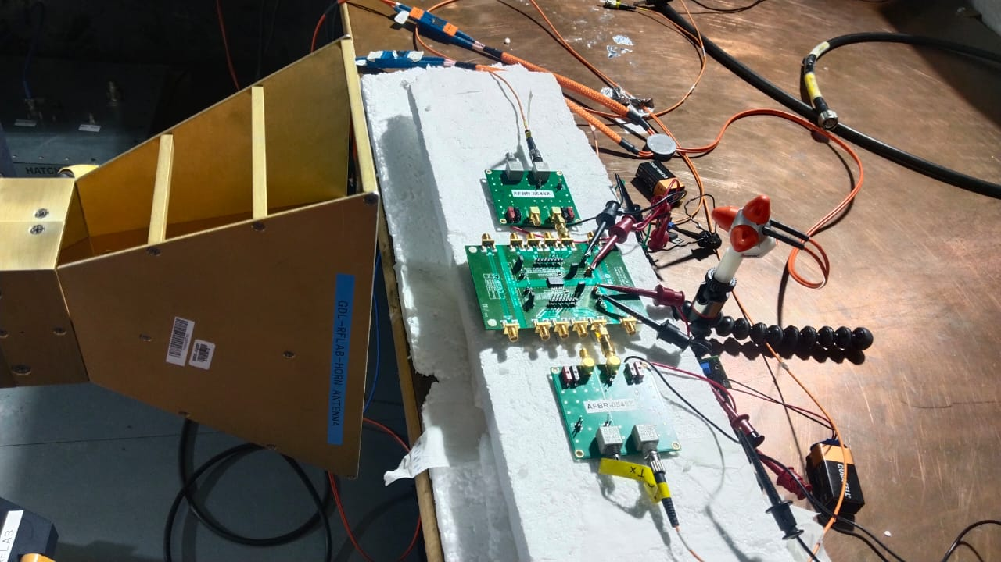
Test setup images

Slide 12
Scope of further improvement
Using Picoscope (with inbuilt function/signal generator) or FPGA development board to make the setup less bulky and automate the testing process.
Programming and automating the testing process allows us to mitigate pulse shape distortion problem and precise identification of cause of failure.
Using Laser based optical to electrical converter gives us greater bandwidth for testing setup
Using Low voltage differential signalling (LVDS) technique can improve robustness of test setup and reliability of results

Slide 13
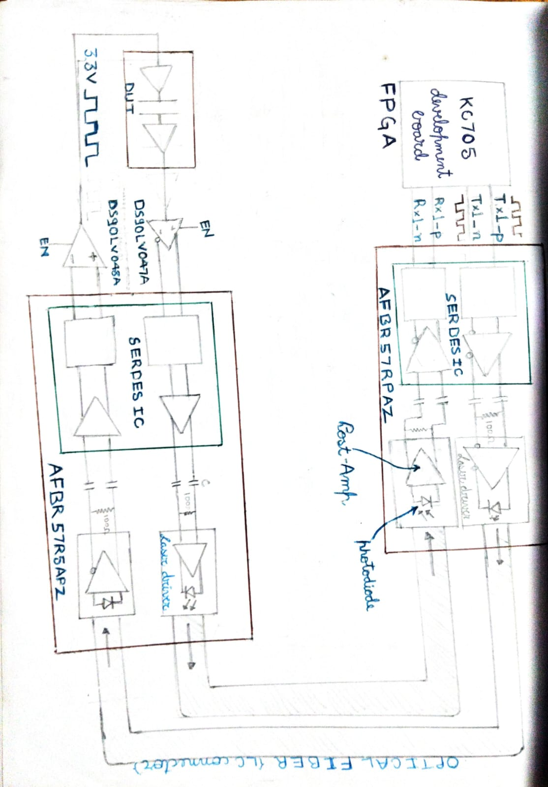
Block Diagram of setup with further improvements

Slide 14

Question
& Answer

Slide 15
Thank You

